Slide 1
Expanded Polystyrene (EPS) Geofoam Applications & Technical Data

Slide 2
EPS Geofoam
Expanded polystyrene (EPS) geofoam used as geotechnical material since the 1960s.
Solves engineering challenges.
Lightweight.
Approximately 1% the weight of soil.
Less than 10% weight of other lightweight fill alternatives.
Reduces loads imposed on adjacent and underlying soil & structures.

Slide 3
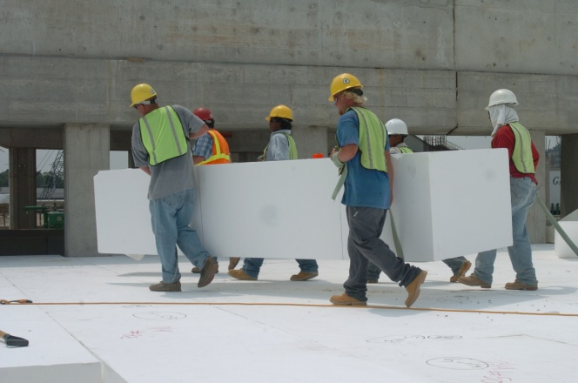
EPS Geofoam Benefits
Accelerates project schedules.
Easy to handle.
Unaffected by weather conditions.
Can be cut & shaped onsite.
Retains physical properties under engineered condition of use.
Arrives onsite having undergone rigorous QA/QC testing.

Slide 4
EPS Geofoam Applications & Use
Road construction over poor soils
Road widening
Bridge abutment
Bridge underfill
Culverts, pipes & buried structures
Compensating foundation
Rail embankment
Landscaping & vegetative green roofs
Retaining & buried wall backfill
Slope stabilization
Stadium & theatre seating
Levees
Airport runway/taxiway
Foundations for lightweight structures
Noise & vibration damping
Compressible application
Seismic application
Permafrost embankments
Rockfall/impact protection

Slide 5
ASTM EPS Geofoam Standards
EPS geofoam is available in different material types.
Thorough knowledge & understanding of the material type being used on an EPS geofoam project is essential.
ASTM D6817 Standard Specification for Rigid Cellular Polystyrene Geofoam
Physical properties & dimensions of EPS geofoam.
ASTM D7180 Standard Guide for the Use of EPS Geofoam in Geotechnical Projects
Design considerations for EPS geofoam.
ASTM D7557 Standard Practice for Sampling of EPS Geofoam Specimens
Quality assurance.

Slide 6
EPS geofoam specification

Slide 7
EPS geofoam applications

Slide 8
Road construction over poor soils
Replaces compressible, soft soils or heavy fill materials.
Prevents unacceptable loading on underlying soils and adjacent structures.
High compressive strength supports interstate traffic loadings.

Slide 9
Road widening
Eliminates need for compaction & fill testing.
Minimizes impact to existing roadway, adjacent structures & buried utilities.
Withstands traffic forces.
Reduces construction time.

Slide 10
Bridge abutment
Safely supports highway loading without over-stressing underlying soils.
Less differential movement at bridge/approach.
Reduces cost of approach slab.
Reduces long term maintenance.
Reduces lateral forces on abutment walls, foundations & other retaining structures.
Savings in design of bridge abutment & other walls.

Slide 11
Bridge underfill
Adds minimal load to underlying ground.
Helps support bridge span & transfer traffic load safely to foundation or underlying soil.

Slide 12
Culverts, pipelines & buried structures
Used in lieu of heavier traditional fills over structures that were not designed to support increased loads.
Eliminates the need for removal or strengthening of existing underground structures.

Slide 13
Compensating foundation
Reduces load on underlying compressible soils.
Minimizes building settlement & potential bearing capacity problems.

Slide 14
Rail embankment
Strong enough to support railway loads.
Does not overload existing soils.
Prevents settlement of adjacent structures & utilities.

Slide 15
Landscaping & vegetative green roofs
Vegetative roof benefits.
Reduce rainwater runoff.
Improve air quality.
Reduce air temperatures.
Can be cut/trimmed onsite to fit odd geometries.
Installed without special equipment.
Does not add any appreciable load to roof structure.
Provides insulation value.

Slide 16
Retaining & buried wall backfill
Reduces lateral pressures on structure.
Limits horizontal forces that can develop during earthquakes.

Slide 17
Slope stabilization
Stabilizes & repairs soil & rock slopes.
Replaces portion of existing soil.
Entire mass slide may not need to be excavated & replaced.
Significant time & cost savings.

Slide 18
Stadium & theatre seating
Tiered seating for auditoriums, movie theatres, gymnasiums & churches.
New construction & renovation projects.

Slide 19
Levees
Provides volume need to return levee to original configuration.
Reduces/eliminates additional stress & cycle of settlement & levee raising.

Slide 20
Airport runway/taxiway
Replaces unsuitable soils without overloading underlying subgrade materials.
Controls settlement on highly compressible & saturated soils.
Prevents differential settlements at intersection of new & existing pavements.

Slide 21
Foundations for lightweight structures
Replaces traditional agricultural pile footings on peat soils.
Little to no settlement of footings.
Advantages
Lightweight
Cost savings
Ease of construction
Transportability for re-use.

Slide 22
Special applications
Noise & vibration dampening
Free-standing walls or embankments to reduce highway noise.
Reduce transmission of ground borne vibrations under railways or pavements.
Compressible application
Designed for strains beyond 1%.
Seismic application
Reduces seismic forces imposed on buried structures, retaining walls, pipelines, etc.
Permafrost embankments
Insulates underlying permafrost & reduces thawing & thaw-consolidation of ice-rich permafrost soils.
Rockfall/impact protection
Improves performance of protection galleries due to high energy absorption.

Slide 23
EPS geofoam design considerations

Slide 24
Design considerations
Lightweight
Manufactured in unit weights ranging from 0.7 – 2.85 lbs/cu³/ft.
Imparts small dead load or stress to underlying soils, structures & utilities.
Eliminates need for specialized foundations or site preloading to reduce settlement & improve bearing capacity.
Reduces lateral stresses behind earth retaining structures.

Slide 25
Design considerations
Strength
Available in a wide range of compressive resistances.
Different types of EPS geofoam can be specified on a single project to maximize savings.
Ease of handling
Handled onsite by laborers or mechanized equipment.
Field cut using hot-wire cutter, hand saw or chain saw.
EPS geofoam design loads are recommended to not exceed the compressive resistance at 1% capacity.
This limit controls the amount of long-term deflection, or creep, resulting from permanent sustained loads.

Slide 26
Design considerations
Construction time
Faster placement rates, reduced utility relocation & less traffic disruption.
Not affected by adverse weather conditions.
Construction cost
Adjacent structures can be designed to be less robust/expensive.
Lower installation & maintenance costs.
Stability
Permanent material when correctly specified & installed.

Slide 27
Design considerations
Insulation
Superior, long-term thermal insulation.
Protection
Can be damaged when exposed to certain hydrocarbons.
Hydrocarbon resistant geomembranes.
Manufactured with flame retardant.
Long-term UV exposure is generally surficial & does not cause detrimental property changes.
High wind speeds should be monitored; sandbags can be placed on top of EPS geofoam to prevent blocks from shifting.

Slide 28
Design considerations
Buoyancy
Adequate surcharge or passive restraint must be provided against uplift.
Water absorption
Closed cell structure of EPS limits water absorption.
Sustainability
Can be reground, recycled and reused in composite applications (lightweight concrete, plastic lumber, etc.)
Reduced transportation & fuel costs.
State-of-the-art manufacturing.

Slide 29
EPS geofoam technical data

Slide 30
EPS geofoam specification

Slide 31
Technical data
Compressive resistance
Design recommendation: limit loading to the compressive resistance at 1% strain.
Stress at compressive strain of 1% = elastic limit stress.

Slide 32
Technical data

Slide 33
Technical data
Creep
Minimal at strain levels below 1%.
Load distribution
Poisson’s ratio ~ 0.12 within the elastic range.
Coefficient of friction
µ = 0.5
R-value
ASTM C578 Standard Specification for Rigid Cellular Polystyrene Thermal Insulation.

Slide 34
Technical data
Water absorption
Closed cell structure of EPS limits water absorption.
If installed in a submerged application, an increase in density will occur over time.
Stability
Resistant to fungi & mold.
No nutritional value to insects.

Slide 35
Technical data

Slide 36
Contacts & resources
EPS Industry Alliance
1298 Cronson Blvd., Suite 201
Crofton MD 21114
800-607-3772
info@epscentral.org
www.epsmolders.org
ASTM International
100 Barr Harbor Drive
West Conshohocken, PA 19428-2959
www.astm.org
U.S. Department of Transportation
Federal Highway Administration
1200 New Jersey Ave. SE
Washington, DC 20590
202-366-4000
www.fhwa.dot.gov
Geofoam Research Center College of Engineering & Computer Science
237 Hinds Hall
Syracuse University
Syracuse, NY 13244-1240
grc@syr.edu
geofoam.syr.edu
National Cooperative Highway Research Program (NCHRP) Transportation Research Board
The National Academies
500 Fifth St. NW
Washington, DC 20001
202-334-2934
www.trb.org/NCHRP/Public/NCHRP.aspx

